Slide 1
Perspectives of enhancing cooperation: Are rapid acceleration of bilateral merchandise trade and Chinese FDI inflows into Serbia can be sustained?
Authors:
Ivan Nikolić, PhD Economics Institute, Belgrade
Goran Nikolić, PhD Institute of European Studies, Belgrade

Slide 2
Introduction
The 14+1 framework under Belt and Road Initiative in Europe is on a slippery slope. The relationship between Brussels and Beijing is rapidly transformed from competition, through systemic rivalry, to decoupling in many areas.
In these circumstances, Serbia, by far the biggest Western Balkans country, is the exception that proves the rule. Even if it finds itself politically between a rock and a hard place, the country has managed to preserve its independence and a balanced relationship between the West and the East. Refused to join EU sanctions against Russia although supports Ukraine, neither.
With the EU's irrational unwillingness to expand to the Balkan, China is successfully filling the geopolitical vacuum with a win-win outcome to accelerate economic development through increased connectivity.
Apart from loan-based projects, Chinese investment is becoming an increasingly important field of bilateral cooperation. Investment has been directed mainly towards Serbia’s export-oriented manufacturing areas, as well as key infrastructural projects.

Slide 3
Research objectives
The aim of this analysis is to examine to what extent the exuberance of economic relations with China helped Serbia as a buffer against negative exogenous shocks caused by the COVID-19 pandemic, as well as Russia’s full-scale invasion of Ukraine.
At the same time, the perspective of this cooperation will be evaluated, especially with regard to the signing of the Memorandum of Understanding, which marked the formal beginning of negotiations on free trade between Serbia and China.
Are there any grounds for optimism about cooperation in the production of emerging technologies, a more coordinated and efficient approach to the green industrial policy that awaits us in the future?

Slide 4
China's investments in Serbia
China's investments in Serbia in recent years have been growing faster than total Chinese OFDI along BRI countries.
In 2015, investments from China in Serbia amounted to a modest 66.5 million euros (or 3.1% of the total FDI inflow), but in 2022, investments reached 1,399.3 million euros (or 31.7% of the total FDI inflow).

Slide 5
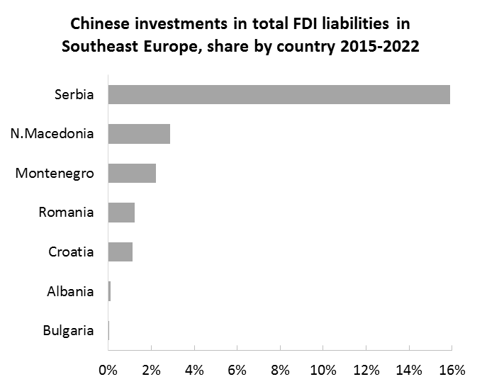
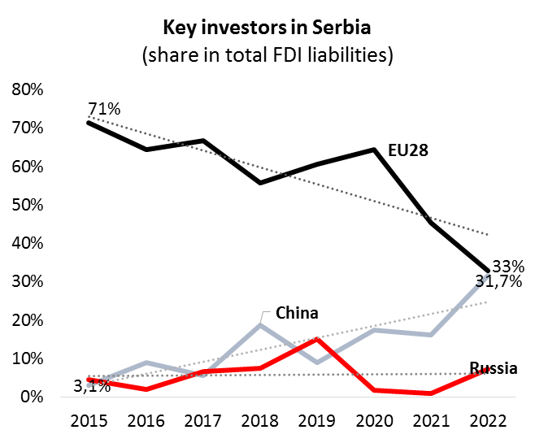
Source: author's calculation

Slide 6
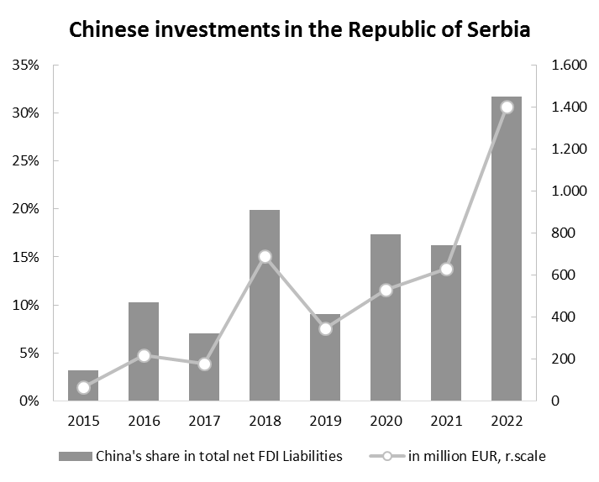
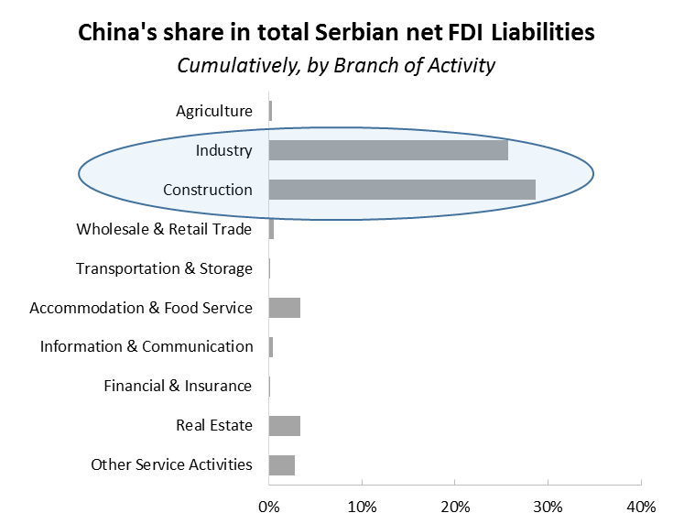
Moreover, 98.2% of these investments were located in the mining, processing industry and construction sectors.
Source: author's calculation

Slide 7
Chinese investments in the Republic of Serbia, by Branch of Activity
Source: author's calculation

Slide 8
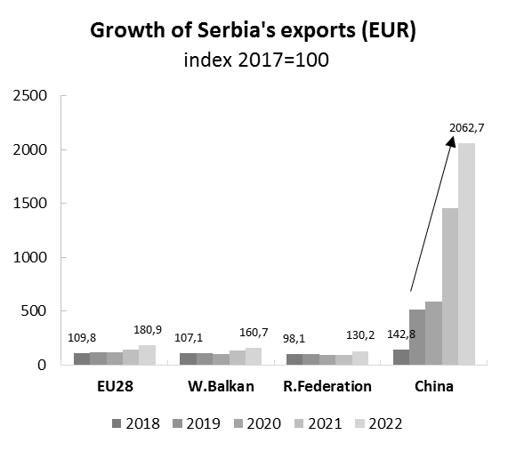
The overall value of exports of the Republic of Serbia in the period 2017-2022 increased from EUR 15 billion to EUR 27.3 billion, respectively Selected destinations of Serbian exports, period 2017-2022 by regions (countries):
 | Contribution to the value increase of exports | Share in the total value of exports
EU28 | 65,2% | 66,2%
W.Balkan | 12,8% | 16,2%
R.Federation | 2,2% | 4,7%
China | 8,8% | 2,3%
Source: author's calculation
In period 2015-2022, the value of trade exchange between Serbia and China increased 4.15 times and Serbia's merchandise exports to China 59.5 times.
After Germany, China has become the second most important economic partner for Serbia.

Slide 9
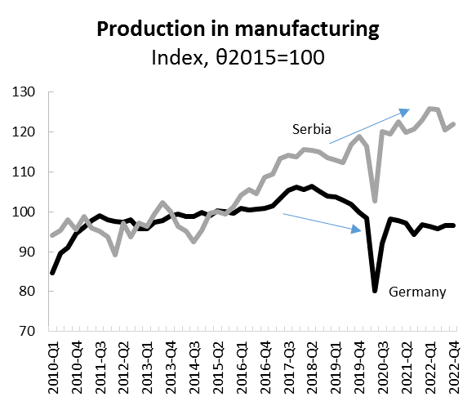
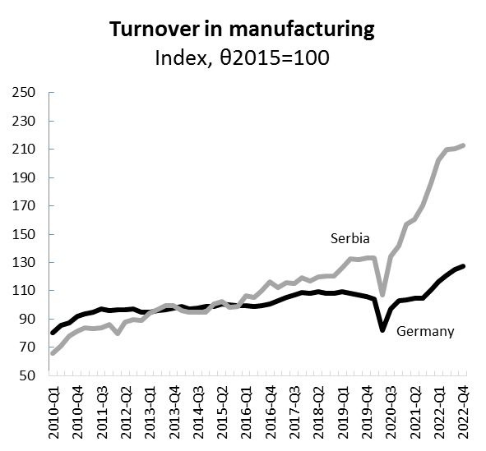
The essential outcome of this process: Serbia vs Germany (EA) - divergence since 2016...
Source: Eurostat data; author's calculation

Slide 10
FTA - expectations and risks
Serbia and China should sign a Free trade Agreement (FTA) by the end of the year...
The food and beverage industry could benefit from the FTA
However, the agreement is important because of the wider context...
In order to increase the export of Serbian products, an agreement alone is not enough. It is necessary to organize more efficient production on a larger scale, more competitive transportation to such a distant market, and of course, to lead a competitive game with other countries that are interested in Chinese consumption.
The negative effect on customs duty revenues!
All this is a complicated process that requires a strategic approach... One must be patient, to slowly and carefully weigh the arguments for and against certain measures.

Slide 11
General conclusion
The reasons for promoting foreign direct investment from China have been different so far.
In this part of Europe, the recipe for Serbia will somehow be a panacea for others. That is why it is a mutual challenge.
Therefore, this work can be useful for policymakers of both countries.

Slide 12
Thank you for your attention

